Slide 1
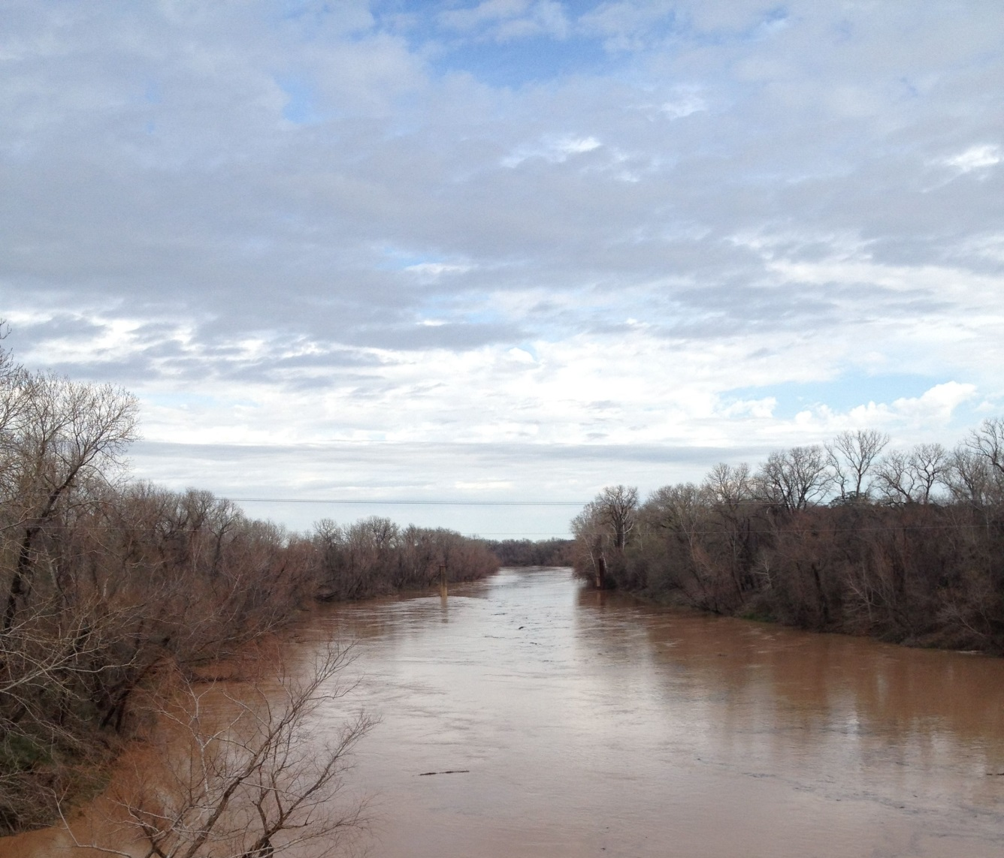
TEXAS BRAZOS RIVER FLOW AND MUSSEL GROWTH RECONSTRUCTIONS USING STABLE OXYGEN, HYDROGEN, AND CARBON ISOTOPES AND TRACE ELEMENTS
PhD defense
Alex Van Plantinga

Slide 2
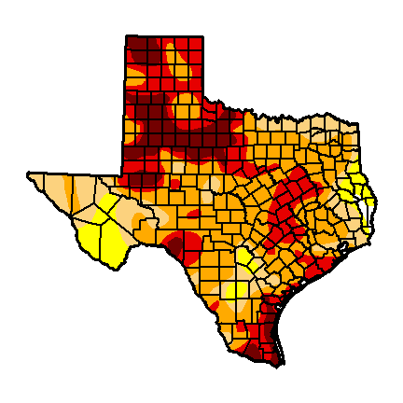
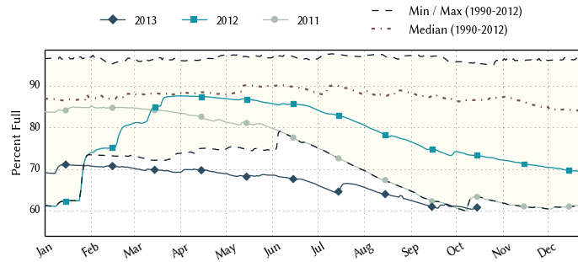
Texas Drought
Precipitation deficit,
July 9, 2013
(US Drought Monitor)
Texas reservoir levels

Slide 3
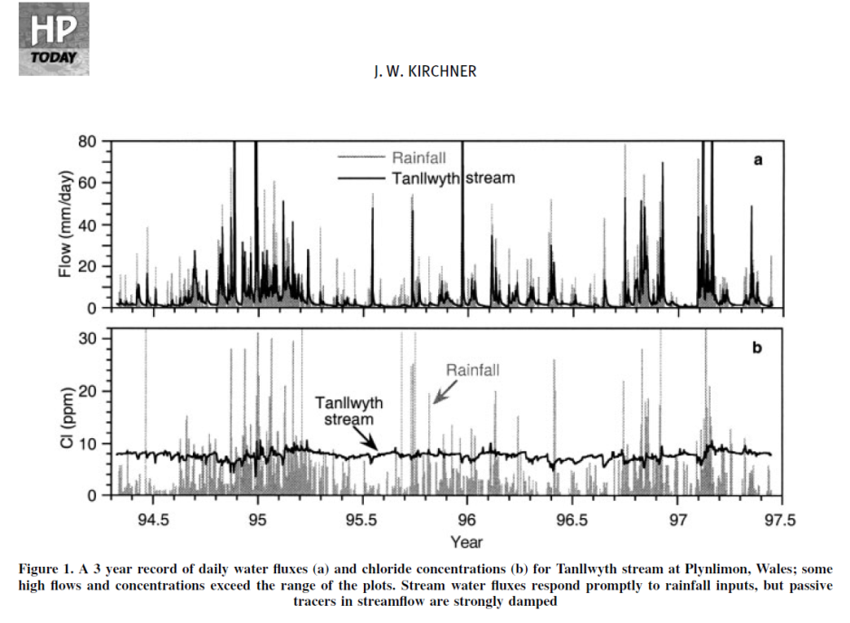
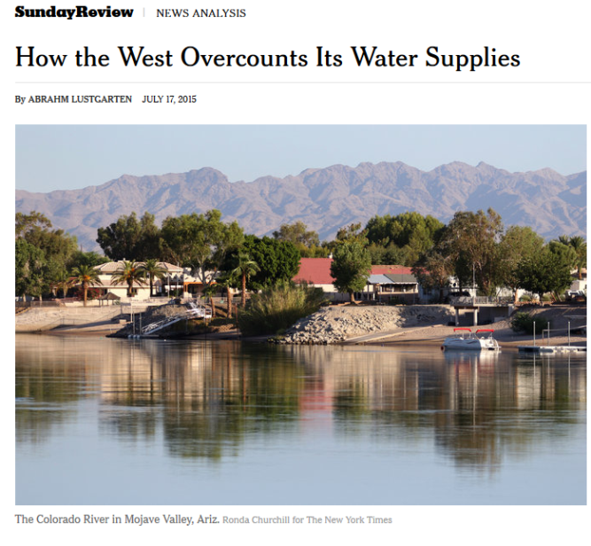
z
http://www.nytimes.com/2015/07/19/opinion/sunday/how-the-west-overcounts-its-water-supplies.html?_r=0

Slide 4
Chapter 1: CHEMICAL AND ISOTOPIC TRACER EVALUATION OF WATER MIXING AND EVAPORATION IN A DAMMED TEXAS RIVER DURING DROUGHT
Characterize end-member chemistry values for flow sources
Predict water chemistry or flow source proportions with a mixing equation
Estimate evaporation from flowing river water

Slide 5
Setting
Lake Whitney
A
B
5
C
enlarged area
Bosque-Waco drainage
Lake Limestone
Brazos River
Little River
Navasota River
7
Brazos Co.
4
2
6
1
3
30 km
1 Sampling Location
Alluvium Aquifer
Flow gage

Slide 6
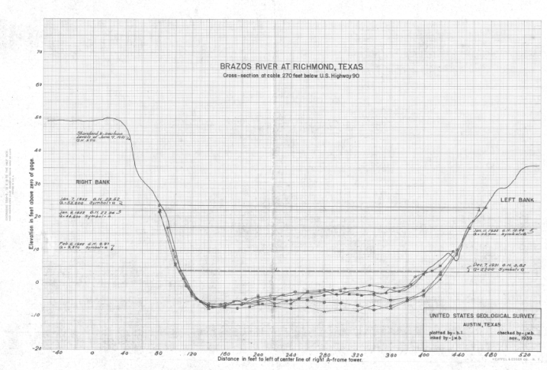
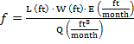
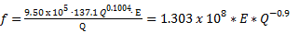
Methods
Collect weekly water samples from Brazos River and local streams
Field measurements for electrical conductivity (µS/cm) and temperature
δ notation for stable isotopes δ in ‰ = 1000*(R_{x} – R_{s}) / R_{s}
Measure δ¹⁸O and δD with a Picarro CRDS system
Model evaporation from the river
f = evaporation rate / discharge
R = R_{o} * f ^{(α - 1)}
δ_{final} + 1000 = (δ_{­initial} + 1000) * f ^{(1 / α’ - 1)}

Slide 7
Methods: Monthly Mixing Model – How well can we reconstruct δ¹⁸O_{BR} on a monthly basis?
δ¹⁸O_{BR} =
f_{BRAA} δ¹⁸O_{BRAA}
+ f_{LW} δ¹⁸O_{LW} (known f value)
+ f_{LR} δ¹⁸O_{LR}
+ f_{RO} δ¹⁸O_{RO}
(use average monthly rain δ¹⁸O)
+ Δ¹⁸O_{E}

Slide 8
Results
2012-2013
2012-2013

Slide 11
Arid vapor source
MWL
Humid vapor source
warmer, lower latitude or altitude, coastal
Ocean Water
Evaporative loss from rivers, reservoirs, lakes
more humid
δD ‰ VSMOW
cooler, higher latitude or altitude, inland
more arid
δ¹⁸O ‰ VSMOW
http://www.sahra.arizona.edu/programs/isotopes/oxygen.html

Slide 12
Lake Whitney and Brazos River spring, summer, and fall water and BRAA water all lie along a mixing and evaporation line.
Brazos River winter water (high-runoff) and city groundwater closely track the Meteoric Water Line

Slide 13
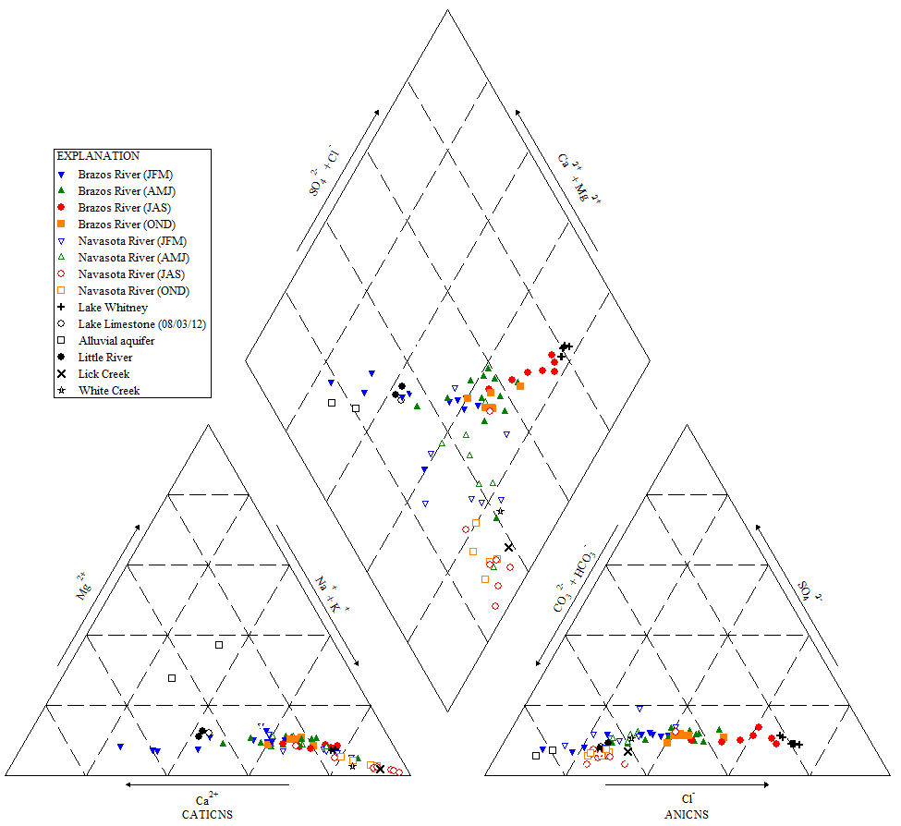
SO₄²⁻ + Cl²⁻
Ca²⁺ + Mg²⁺
CO₃²⁻ + HCO₃⁻
Mg²⁺
Na⁺ + K⁺
SO₄²⁻
Ca²⁺
Cl⁻

Slide 15
BR, season | variable | µ | σ | min | max
JFM | δ¹⁸O, δD | -3.9, -25 | 1.5, 11 | -7, -49 | -1.3, -11
AMJ | δ¹⁸O, δD | -2.1, -13 | 0.8, 4 | -3, -18 | -0.3, 0
JAS | δ¹⁸O, δD | -0.8, -8 | 0.9, 3 | -2.3, -13 | 1.3, 0
OND | δ¹⁸O, δD | -1.8, -14 | 0.8, 5 | -4, -30 | -1, -10
variable | BR all | LW | NR | Lick | White | Little River
δ¹⁸O µ, σ | -2.2, 1.5 | -1.2, 0.8 | -3.1, 1.1 | -4.0, 0.6 | -3.3, 1.3 | -2.3, 1
δD µ, σ | -15, 9 | -10, 3 | -18, 7 | -20, 4 | -10, 3 | -15, 6
δ¹⁸O_{BR} = f_{BRAA} δ¹⁸O_{BRAA} + f_{LW} δ¹⁸O_{LW} + f_{LR} δ¹⁸O_{LR} + f_{RO} δ¹⁸O_{RO} + Δ¹⁸O_{E}

Slide 16
Conclusions
Characterized chemistry of water sources and identified chemical endmembers
Estimated evaporative enrichment (Δ¹⁸O_{E}) in the flowing river water
Mixing model can accurately reconstruct water chemistry and flow source proportions

Slide 17
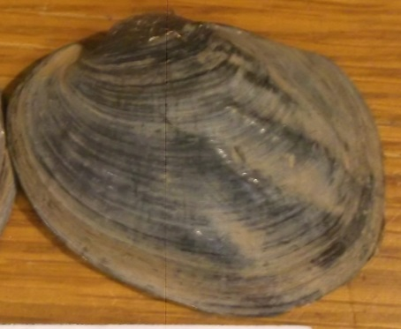
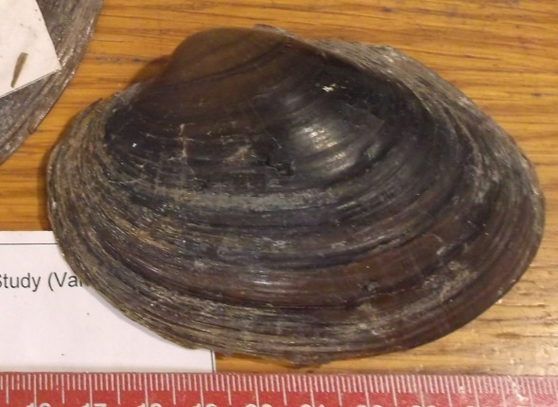
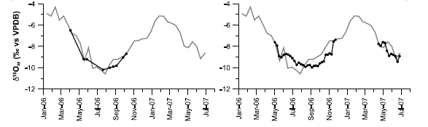
Chapter 2: STABLE AND CLUMPED ISOTOPE SCLEROCHRONOLOGIES OF MUSSELS FROM THE BRAZOS RIVER, TEXAS: ENVIRONMENTAL AND ECOLOGIC PROXY
Objectives
Compare the record of river water stable isotope and temperature values with shell clumped and stable isotope values to reconstruct mussel shell growth, assign growth chronologies
Compare shell isotope values and growth patterns in two different species and between modern and historical specimens
Determine how well shell chemistry reconstructs river discharge, water source and salinity
Amblema plicata
Cyrtonaias tampicoensis
7 cm
Versteegh et al., 2010

Slide 18
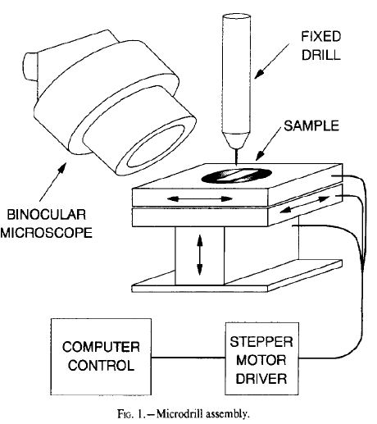
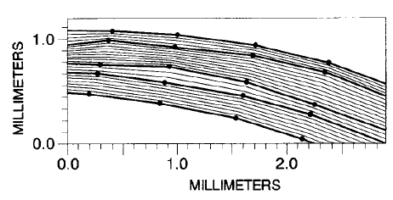
Methods
Section, polish, micromill shells for isotope and trace element analyses (60-140 µm)
Analyze on TAMU SIGF Kiel MAT 253 IRMS
Sample dark and light bands and extreme δ¹⁸O regions for clumped isotopes with a 0.5 mm drill bit.
Analyze Δ₄₇ at JHU custom CO₂ purification line - MAT 253 IRMS

Slide 19
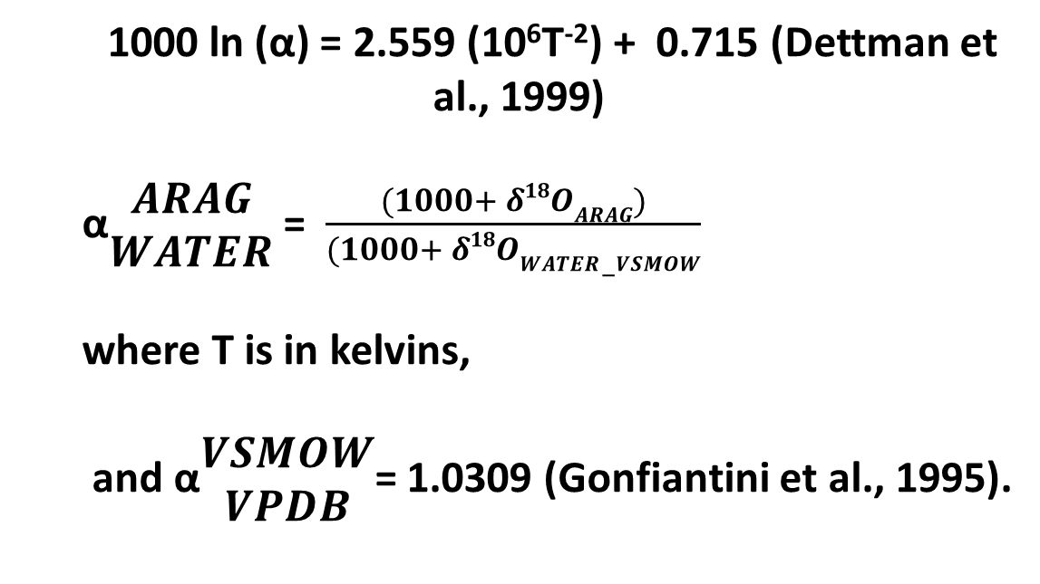
1000 ln (α) = 2.559 (10⁶T⁻²) + 0.715 (Dettman et al., 1999)
α$\begin{matrix}ARAG \\ WATER\end{matrix}$ = $\frac{(1000+ δ18OARAG)}{(1000+ δ18OWATER−VSMOW}$
where T is in kelvins,
and α$\begin{matrix}VSMOW \\ VPDB\end{matrix}$= 1.0309 (Gonfiantini et al., 1995).
Calibrate using Dennis et al. (2011)
Henkes et al. (2013) paleotemperature equation:
Δ₄₇ = 0.0327 * 10⁶ / T² + 0.3286

Slide 20
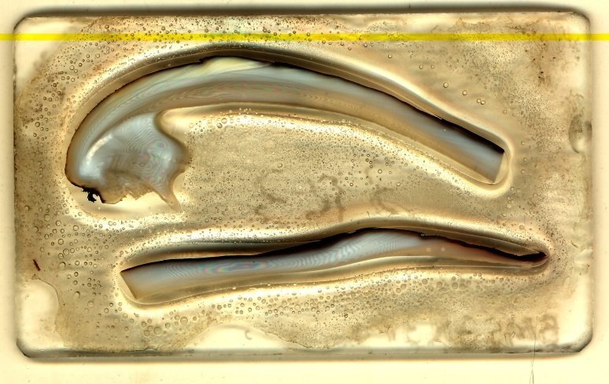
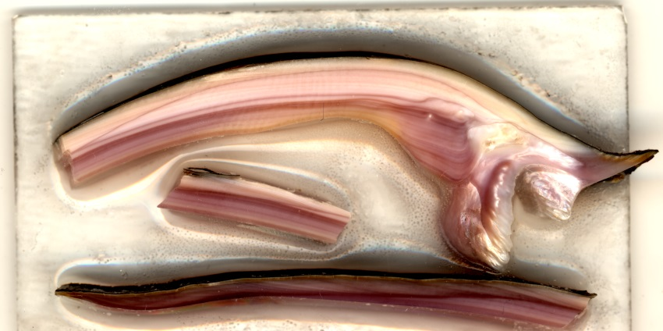
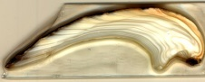
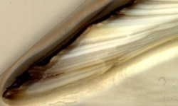
Amblema plicata
Cyrtonaias tampicoensis
VM cont.
INL
VM
INL
VM
INL
VM
INL
VM
VM

Slide 21
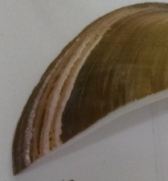
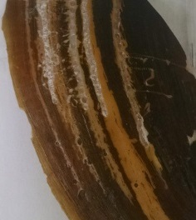
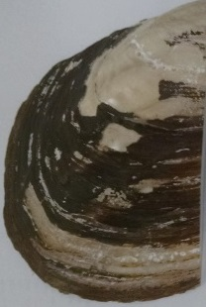
Clumped samples from tops of the shells (30 mg powder per band)
G
E
F

Slide 22
Stable isotope results
 |  |  | δ¹⁸O ‰ |  |  |  | δ¹³C ‰
 |  |  | x̄ | µ | min | max | x̄ | µ | min | max | N | Ḡ | σ
Threeridge | 3R5 | VM | -2.8 | 0.8 | -4.6 | -1.3 | -9.3 | 1.7 | -14.2 | -6.7 | 58 | 8.2 | 2.3
 |  | INL | -2.7 | 0.8 | -4.7 | -1.5 | -9.1 | 1.9 | -13.3 | -6.0 | 48 | 3.4 | 1.4
 | 3R3 | VM | -2.8 | 0.7 | -4.6 | -1.4 | -9.8 | 1.4 | -13.2 | -7.0 | 57 | 6.8 | 1.8
 |  | INL | -3.1 | 0.2 | -5.0 | -1.3 | -9.2 | 1.6 | -12.4 | -6.7 | 32 | 1.8 | 0.6
 | H3R | VM | -3.8 | 0.1 | -5.3 | -1.8 | -9.5 | 0.1 | -10.6 | -7.9 | 56
Tampico | TP2 | VM | -2.8 | 1.0 | -4.5 | -0.4 | -12.2 | 2.1 | -16.6 | -8.9 | 43 | 3.0 | 1.8
 |  | INL | -3.2 | 0.6 | -4.1 | -2.0 | -11.3 | 1.7 | -14.6 | -8.7 | 25 | 5.8 | 3.6
 | TP3 | VM | -2.7 | 0.6 | -4.4 | -1.3 | -12.4 | 2.0 | -16.8 | -8.9 | 62 | 9.2 | 4.9
 |  | INL | -2.8 | 0.8 | -4.5 | -1.1 | -12.1 | 2.2 | -14.9 | -7.9 | 34 | 4.9 | 2.0
 | HTP | VM | -3.2 |  |  |  | -11.6 |  |  |  | 2

Slide 23
Results

Slide 24
Clumped isotope results
No growth band trends
Sample | Δ₄₇ | σ | TºC | σ | δ¹⁸O _{WATER} | σ | B
3R5_0.3 | 0.667 | 0.006 | 33 | 3 | -0.4 | 0.7 | D
3R5_0.9 | 0.668 | 0.009 | 32 | 4 | -0.3 | 0.9 | D
3R5_3.9 | 0.697 | 0.008 | 21 | 3 | 1.5 | 0.6 | L
3R5_4.6 | 0.700 | 0.007 | 19 | 3 | 1.3 | 0.6 | D
TP2_0.3 | 0.661 | 0.012 | 35 | 5 | -1.2 | 1.2 | L
TP2_1.4 | 0.684 | 0.012 | 26 | 5 | 0.8 | 1.1 | L
TP2_2.7 | 0.671 | 0.001 | 31 | 1 | 0.5 | 0.1 | L
TP2_3.2 | 0.661 | 0.005 | 36 | 2 | -0.8 | 0.6 | L
TP2_4.9 | 0.678 | 0.010 | 28 | 4 | 0.8 | 1.0 | D
H3R_0.3 | 0.659 | 0.011 | 36 | 4 | -1.3 | 1.0 | D
H3R_2.0 | 0.681 | 0.004 | 27 | 2 | -2.5 | 0.4 | D
H3R_4.3 | 0.672 | 0.007 | 31 | 3 | 0.1 | 0.6 | L
H3R_5.7 | 0.671 | 0.009 | 31 | 4 | -0.6 | 0.9 | D

Slide 25
Shell growth chronologies
Step 1: identify warm and cool shell intervals
Figure 6. Clumped isotope temperatures and δ¹⁸O_{water_ Δ47} chronologies combining 3R5 and TP2 data, based on the δ¹⁸O_{shell} chronologies .

Slide 26
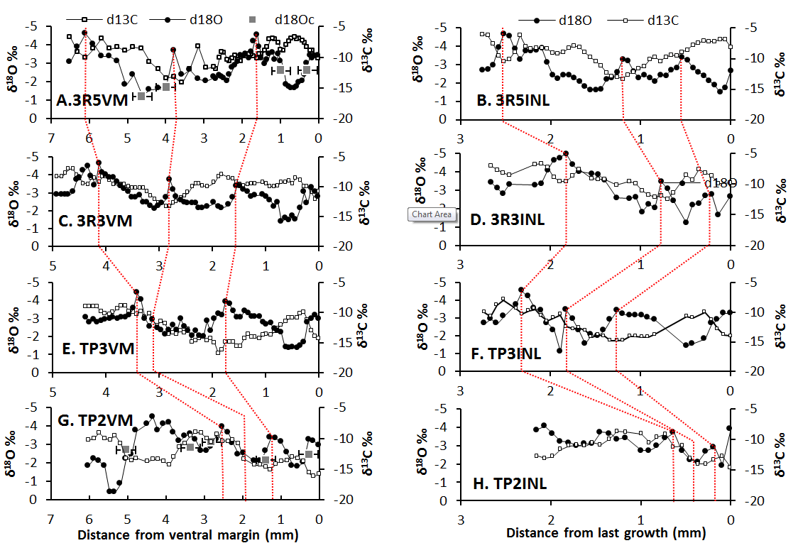
Step 2: Identify and align peaks and troughs in shell δ¹⁸O profiles

Slide 27
Step 3: Match shell δ¹⁸O to predicted δ¹⁸O
Threeridge (Amblema plicata)
Tampico (Cyrtonaias tampicoensis)
TP2VM
TP2INL
δ¹⁸O ‰
δ¹³C ‰
TP3VM
TP3INL
2012-2013
2012-2013
Notes:
Figure 5. Assigned isotope chronologies for 3R5VM (A), 3R5INL (B), 3R3VM (C), 3R3INL (D), TP2VM (E), TP2INL (F), TP3VM (G), and TP3INL (H).

Slide 28
Shell growth rate estimates (extension rate)
Faster in VM than in INL
Growth rate (mm/yr)
TP3
Notes:
Figure 7. Growth rate (mm/yr) for 3R5 (A), 3R3 (B), TP2 (C), and TP3 (D), where the gray line is INL growth rate and the black line is VM growth rate.

Slide 29
May-Sep, poor relationship because of LW influence
Use “BR all” equation
0.1 difference in r values but double the degrees of freedom.
Reconstructing river discharge

Slide 30
T (°C) = 9 * COS(date/56.88) + 23, combined with shell δ¹⁸O to back out water δ¹⁸O
Shell reconstructed vs. actual: Pearson’s r = 0.322, (p < 0.05) for n = 56

Slide 31
Pearson’s r values
 |  | %LW | EC | n
3R5VM | δ¹⁸O | 0.16 | 0.29 | 56
 | δ¹³C | 0.42 | 0.42 | 56
3R5INL | δ¹⁸O | 0.08 | 0.32 | 45
 | δ¹³C | 0.34 | 0.40 | 45
3R3VM | δ¹⁸O | 0.26 | 0.10 | 66
 | δ¹³C | 0.46 | 0.28 | 66
3R3INL | δ¹⁸O | -0.16 | -0.25 | 29
 | δ¹³C | 0.56 | 0.43 | 29
Tp2Vm | δ¹⁸O | -0.12 | -0.01 | 33
 | δ¹³C | 0.07 | 0.43 | 33
TP2INL | δ¹⁸O | -0.08 | 0.01 | 22
 | δ¹³C | 0.48 | 0.47 | 22
TP3VM | δ¹⁸O | 0.42 | 0.21 | 59
 | δ¹³C | 0.51 | 0.76 | 59
TP3INL | δ¹⁸O | 0.22 | 0.20 | 32
 | δ¹³C | 0.39 | 0.71 | 32
Carbon appears to predict %LW and EC better than oxygen, based on the assigned chronologies.

Slide 32
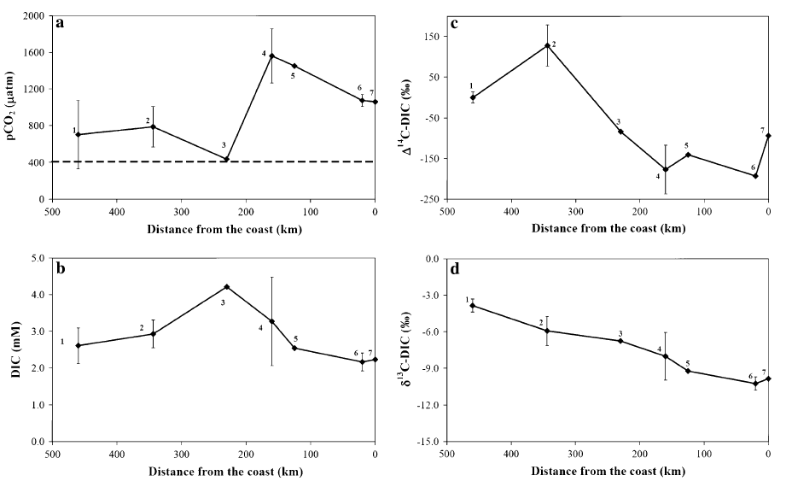
1 – Granbury 2 - Waco 3 - College Station
4 - US 290 5 - FM 14586 6 - Near river mouth 7 - at river mouth
Zeng et al., 2011

Slide 33
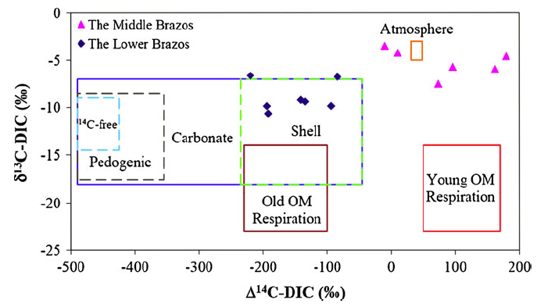
Zeng et al., 2011

Slide 34
Using TP3VM δ¹⁸O and δ¹³C
Water source
r = 0.61 (p < 0.05)
Salinity
r = 0.25
(p > 0.05)

Slide 35
Conclusions
Lower δ¹³C in Tampico than in Threeridge, more “metabolic” carbon?
Not enough specimens to contrast historical and modern conditions.
Shell chronologies assigned, consistent winter growth hiatuses in both species.
Similar values in INL and VM, but lower resolution and smaller ranges in INL.
Shells can be used to accurately reconstruct variation in records of discharge and water source.

Slide 36
Chapter 3 – Trace elements in freshwater mussel shells from the Brazos River in Texas: environmental versus biological controls
Examine molar trace metal to calcium values from micromilled paired isotope samples in one Threeridge and one Tampico mussel specimen from the inner nacreous layer (INL) and ventral margin (VM) regions in each shell.
Determine whether the control on Sr/Ca, Mn/Ca, Ba/Ca, and Mg/Ca was environmental, biological, or both environmental and biological.
Methods
HR-ICP-MS of split isotope-trace element samples
Comparison between transects within shells and between different shells.
Cathodoluminescence and ImageJ analysis of CL photomosaics

Slide 37
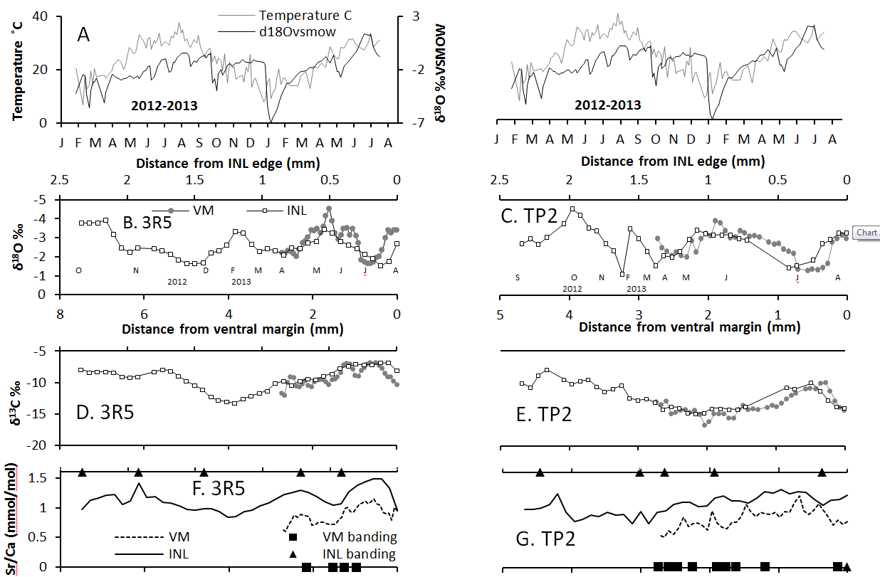

Slide 38
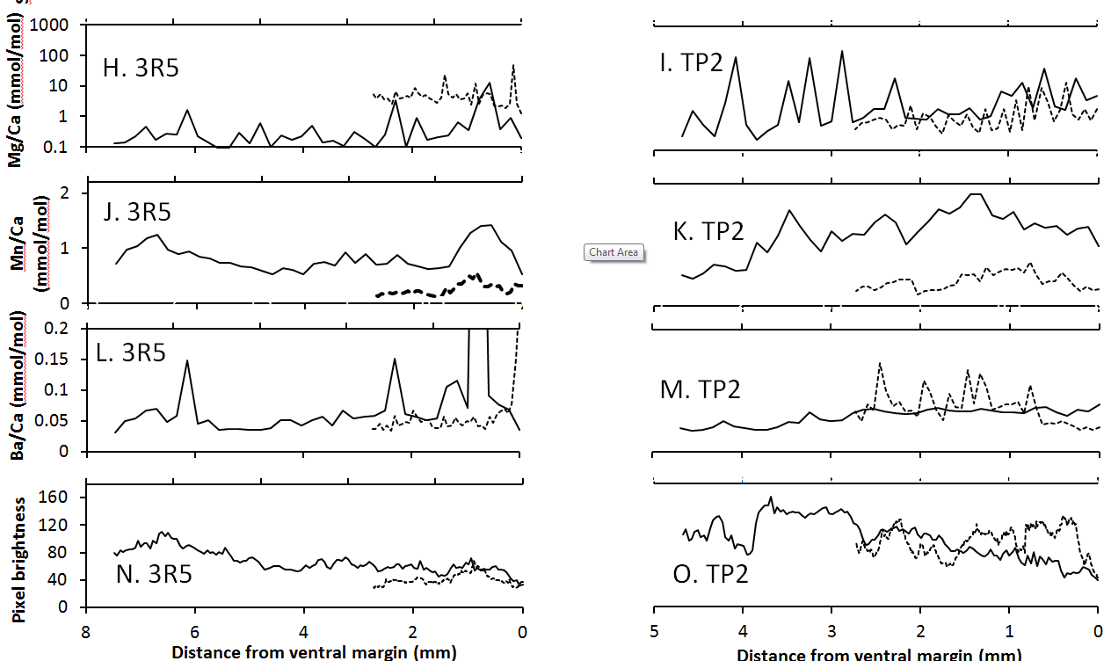

Slide 39
 |  | Mg/Ca | Mn/Ca | Ba/Ca | δ¹³C | δ¹⁸O | T ˚C | G | EC (µS) | %LW | Q (cfs) | Inter-shell | CL
3R5 (INL) | Sr/Ca | 0.477 | 0.755 | 0.391 | 0.681 | 0.188 | 0.430 | -0.021 | 0.228 | 0.357 | 0.024 | 0.574
 | Mg/Ca |  | 0.507 | 0.273 | 0.247 | 0.204 | 0.251 | -0.077 | 0.033 | 0.498 | -0.018 | 0.005
 | Mn/Ca |  |  | 0.457 | 0.556 | -0.047 | 0.273 | 0.324 | 0.168 | 0.315 | -0.129 | -0.113 | 0.641
 | Ba/Ca |  |  |  | 0.236 | 0.107 | 0.235 | -0.057 | 0.002 | 0.289 | -0.080 | 0.080
 | δ¹³C |  |  |  |  | -0.002 | 0.645 | 0.228 | 0.306 | 0.243 | -0.008 | 0.182
 | δ¹⁸O |  |  |  |  |  | -0.051 | -0.403 | 0.447 | 0.391 | -0.290 | 0.631
 | T ˚C |  |  |  |  |  |  | -0.045 | 0.213 | 0.467 | 0.101 | 0.901
 | G |  |  |  |  |  |  |  | 0.282 | -0.131 | -0.181 | -0.192
3R5 (VM) | Sr/Ca | -0.129 | 0.739 | 0.172 | 0.776 | 0.460 | 0.109 | -0.137 | 0.513 | 0.055 | -0.309 | 0.090
 | Mg/Ca |  | 0.217 | 0.015 | -0.010 | -0.050 | 0.146 | -0.258 | 0.090 | -0.079 | -0.063 | 0.380
 | Mn/Ca |  |  | 0.196 | 0.559 | 0.262 | -0.061 | -0.083 | 0.309 | -0.323 | -0.108 | -0.034 | 0.605
 | Ba/Ca |  |  |  | -0.118 | -0.193 | 0.063 | -0.195 | 0.219 | -0.016 | 0.143 | -0.222
 | δ¹³C |  |  |  |  | 0.269 | 0.614 | -0.088 | 0.455 | 0.449 | -0.137 | 0.726
 | δ¹⁸O |  |  |  |  |  | -0.203 | 0.181 | 0.530 | 0.499 | -0.351 | 0.884
 | T ˚C |  |  |  |  |  |  | -0.500 | 0.255 | 0.174 | -0.009 | 0.939
 | G |  |  |  |  |  |  |  | -0.173 | 0.059 | -0.253 | 0.247
TP3INL | Sr/Ca | -0.292 | 0.440 | 0.645 | -0.331 | 0.288 | 0.738 | 0.387 | -0.014 | 0.410 | -0.078
 | Mg/Ca |  | -0.148 | -0.046 | 0.122 | 0.185 | -0.210 | -0.168 | 0.129 | -0.047 | -0.059
 | Mn/Ca |  |  | 0.713 | -0.623 | 0.286 | 0.182 | -0.212 | -0.506 | -0.234 | -0.610 |  | 0.395
 | Ba/Ca |  |  |  | -0.743 | 0.437 | 0.361 | -0.119 | -0.379 | -0.073 | -0.423
 | δ¹³C |  |  |  |  | -0.019 | -0.189 | 0.154 | 0.709 | 0.389 | 0.360
 | δ¹⁸O |  |  |  |  |  | -0.125 | -0.138 | 0.196 | 0.215 | -0.421
 | T ˚C |  |  |  |  |  |  | 0.619 | 0.199 | 0.447 | 0.224
 | G |  |  |  |  |  |  |  | -0.014 | 0.410 | -0.078
TP3VM | Sr/Ca | 0.371 | 0.690 | 0.174 | 0.444 | 0.352 | 0.488 | 0.490 | 0.215 | 0.576 | -0.299
 | Mg/Ca |  | 0.266 | -0.097 | 0.429 | 0.340 | 0.077 | 0.228 | 0.298 | 0.452 | -0.171
 | Mn/Ca |  |  | 0.249 | 0.296 | 0.256 | 0.377 | 0.544 | 0.095 | 0.361 | -0.560
 | Ba/Ca |  |  |  | -0.402 | -0.248 | -0.182 | 0.172 | -0.542 | -0.287 | -0.098 |  | 0.461
 | δ¹³C |  |  |  |  | 0.724 | 0.193 | 0.311 | 0.777 | 0.711 | -0.341
 | δ¹⁸O |  |  |  |  |  | -0.228 | 0.275 | 0.667 | 0.670 | -0.468
 | T ˚C |  |  |  |  |  |  | 0.186 | 0.213 | 0.229 | -0.010
 | G |  |  |  |  |  |  |  | 0.007 | 0.376 | -0.054

Slide 40
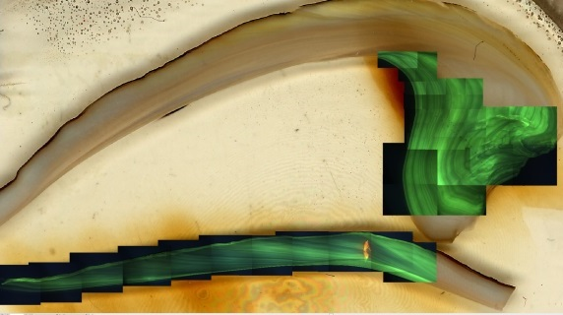
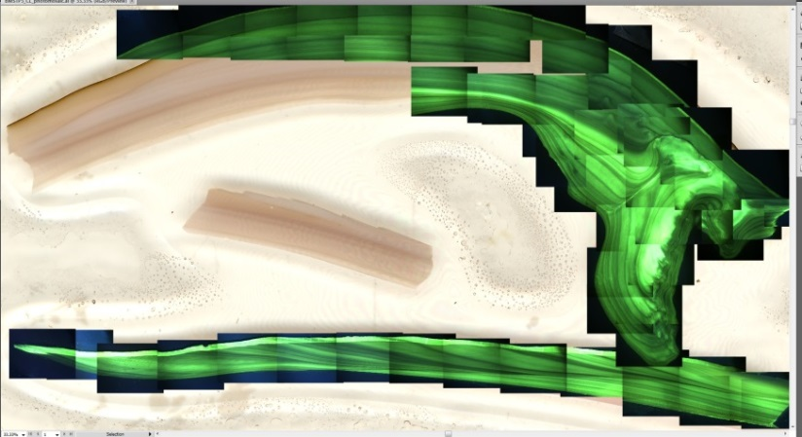
CL results
Banding similar to but not the same light-dark pattern as optical scan bands
Pattern in the white rectangles correlates with Mn/Ca
Mn²⁺ substitutes for Ca²⁺ in the shell aragonite
a.3R5
1cm
b. TP3

Slide 41
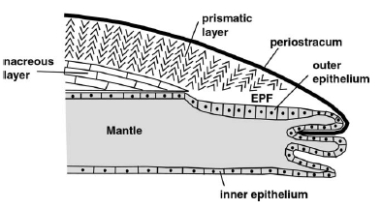
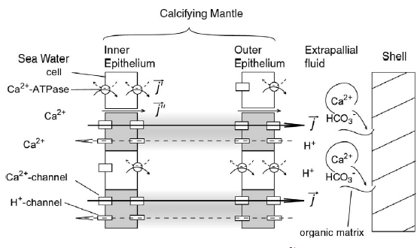
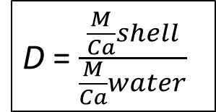
Proposed mechanisms from Carré et al. (2006)
D = $\frac{\frac{M}{Ca}shell}{\frac{M}{Ca}water}$

Slide 42
Conclusions
Consistent relationships between Sr/Ca, Mn/Ca, and δ¹³C
δ¹³C correlates with Lake Whitney flow, and is a useful proxy, although
Sr/Ca probably influenced by seasonal temperature pacing metabolic rate, as in previous studies.
Mn/Ca not as closely related to temperature or Lake Whitney releases. Could be metabolically regulated, or related to food or dissolved oxygen.
Inner nacreous layer has higher Mn/Ca and Sr/Ca values than outer nacreous layer – why?

Slide 43
Acknowledgements
The College of Geosciences provided a generous fellowship.
My committee was very supportive
Geology and Geophysics department.
This work was funded by the Michel T. Halbouty Chair in Geology at Texas A&M University.
Beth Stockert, Jessica Robertson, Destiny Winning, Paul Westbrook, Stephanie Grotte, Tiffany D., Patricia Nicolson collected samples and water data.
Texas A&M University Agrilife Extension Soil Water Forage Testing Lab for analyzing sample water quality.
Thanks to Jason West, Gretchen Miller, Ralph Wurbs, Clyde Munster, Peter Knappett, and Kim Rhodes for advice and insight.
Flow data were provided by the United State Geological Survey, Chris Higgins at the Brazos River Authority, and the US Army Corps of Engineers.
Evaporation-precipitation data were provided by the Texas Water Development Board.
Charles Randklev and Eric Tsakiris collected the mussel specimens. Charles Randklev and Robert G. Howells provided helpful perspective on mussel ecology.
Ben Passey, Naomi Levin, Huanting Hu, Haoyuan Ji, Sophie Lehmann, Dana Brenner, and Lai Ming provided valuable assistance at the Johns Hopkins University Stable Isotope Lab.

Slide 44
Acknowledgements
Chris Maupin, Lauren Graniero, Andrew Roark, and Brendan Roark helped run isotope samples at the Stable Isotope Geoscience Facility.
Thanks to Luz Romero and the Williams Radiogenic Isotope Geosciences Laboratory for the ICP-MS work.
Ann Molineux and the Non-Vertebrate Paleontology Laboratory provided the historical specimens.
Thanks to Ray Guillemette and Lindsey Hunt for EPMA analyses.
Mike Tice helped with XRF trials.
Jian Gong helped with 3-D scanning.

Slide 46
Supplementary figure: Bivariate plots of Mn/Ca vs. Sr/Ca, Mn/Ca vs. Ba/ca, δ¹³C vs. Sr/Ca, δ¹³C vs. Mn/Ca, δ¹³C vs. %LW (% of discharge from Lake Whitney releases) in TP3INL, TP3VM, 3R5INL, 3R5VM.

Slide 47
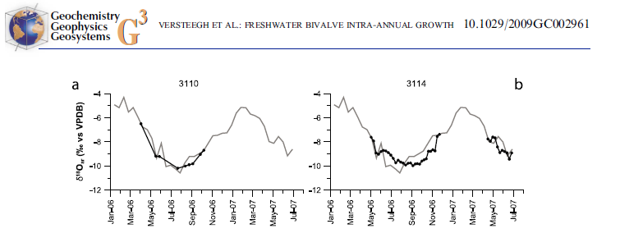
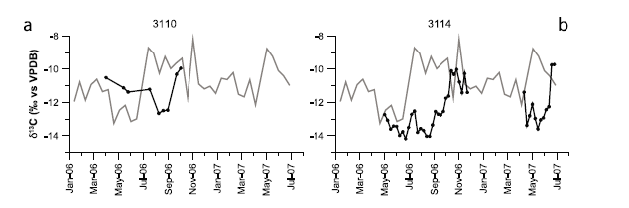

Slide 48
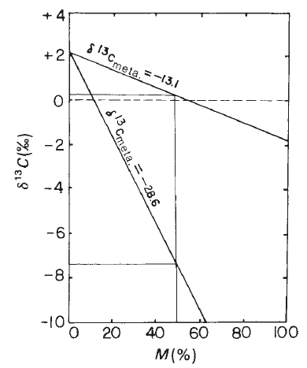
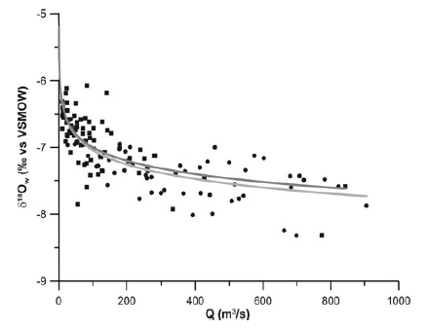
Versteegh et al., 2011
Tanaka et al., 1986

Slide 49
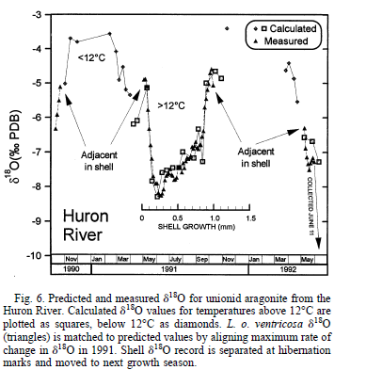
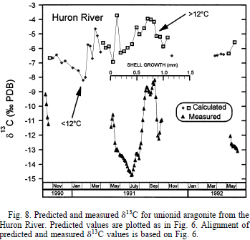
Dettman et al., 1999

Slide 50
References
Carré, M., Bentaleb, I., Bruguier, O., Ordinola, E., Barrett, N. T., and Fontugne, M., 2006, Calcification rate influence on trace element concentrations in aragonitic bivalve shells: Evidences and mechanisms: Geochimica et Cosmochimica Acta, v. 70, no. 19, p. 4906-4920.
Chowdhury, A., Osting, T., Furnans, J., Mathews, R., 2010, Groundwater-Surface Water Interaction in the Brazos River Basin: Evidence from Lake Connection History and Chemical and Isotopic Compositions: Texas Water Development Board Report, v. 375, August, 61 p.
Dennis, K. J., Affek, H. P., Passey, B. H., Schrag, D. P., and Eiler, J. M., 2011, Defining an absolute reference frame for ‘clumped’isotope studies of CO 2: Geochimica et Cosmochimica Acta, v. 75, no. 22, p. 7117-7131.
Dettman, D. L., and Lohmann, K. C., 1995, Microsampling Carbonates for Stable Isotope and Minor Element Analysis: Physical Separation of Samples on a 20 Micrometer Scale: RESEARCH METHOD PAPER: Journal of Sedimentary Research, v. 65, no. 3.
Dettman, D. L., Reische, A. K., and Lohmann, K. C., 1999, Controls on the stable isotope composition of seasonal growth bands in aragonitic fresh-water bivalves (Unionidae): Geochimica et Cosmochimica Acta, v. 63, no. 7, p. 1049-1057.
Gillikin, D. P., Lorrain, A., Navez, J., Taylor, J. W., André, L., Keppens, E., Baeyens, W., and Dehairs, F., 2005, Strong biological controls on Sr/Ca ratios in aragonitic marine bivalve shells: Geochemistry, Geophysics, Geosystems, v. 6, no. 5, 16p.
Gonfiantini, R., 1986, Environmental isotopes in lake studies: Handbook of environmental isotope geochemistry, v. 2, p. 113-168.
Grossman, E. L., and Ku, T.-L., 1986, Oxygen and carbon isotope fractionation in biogenic aragonite: temperature effects: Chemical Geology: Isotope Geoscience section, v. 59, p. 59-74.
Henkes, G. A., Passey, B. H., Wanamaker, A. D., Grossman, E. L., Ambrose, W. G., and Carroll, M. L., 2013, Carbonate clumped isotope compositions of modern marine mollusk and brachiopod shells: Geochimica et Cosmochimica Acta, v. 106, p. 307-325.
Kinsman, D. J., and Holland, H., 1969, The co-precipitation of cations with CaCO 3—IV. The co-precipitation of Sr 2+ with aragonite between 16 and 96 C: Geochimica et Cosmochimica Acta, v. 33, no. 1, p. 1-17.
Versteegh, E. A., Vonhof, H. B., Troelstra, S. R., Kaandorp, R. J., and Kroon, D., 2010a, Seasonally resolved growth of freshwater bivalves determined by oxygen and carbon isotope shell chemistry: Geochemistry, Geophysics, Geosystems, v. 11, n. 8, 16 p.
Versteegh, E. A. A., Vonhof, H. B., Troelstra, S. R., and Kroon, D., 2010b, Can shells of freshwater mussels (Unionidae) be used to estimate low summer discharge of rivers and associated droughts?: International Journal of Earth Sciences, v. 100, no. 6, p. 1423-1432.

